Slide 1

MACHINE LEARNING
HOUSE PRICE PREDICTION
Presented by: Vineetha Susan Alexander

Slide 2
PROBLEM STATEMENT
Introduction:
Overview of the real estate market.
Rapid urbanization and economic growth have led to a complex and dynamic housing market.
Challenge:
Real estate prices are crucial to the economy, yet precise pricing models are still missing.
Despite vast amounts of data, accurately determining house prices remains a challenge.
Implementing fair and transparent pricing can greatly enhance trust and transparency in the real estate market, benefiting both consumers and the industry.
Objective:
Develop a machine learning model that can accurately predict house prices in a city, helping buyers, sellers, and real estate agents make informed decisions.
Significance:
Improving prediction accuracy can lead to more efficient pricing strategies, better investment decisions, and enhanced customer satisfaction.

Slide 3
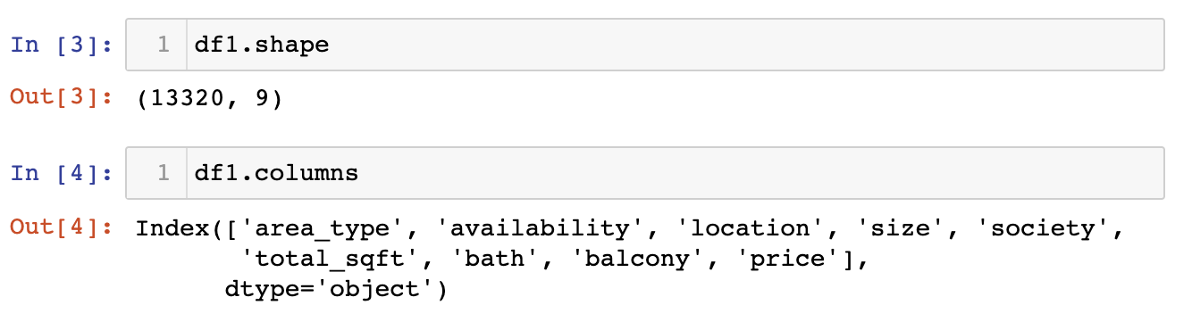
DOMAIN KNOWLEDGE
Understanding the Real Estate Market:
Key Factors Influencing House Prices:
Location: Based on proximity to schools, workplaces, and transportation location can be selected by customers.
Property Features: Size, number of bedrooms, amenities like bathrooms decides on price .
Economic Indicators: Market demand, and economic conditions.
Data Sources:
Dataset with columns : 'area_type', 'availability', 'location', 'size', 'society', 'total_sqft', 'bath', 'balcony', 'price’
Impact of Domain Knowledge:
Leveraging expertise in the real estate domain to identify critical features and relationships.
Incorporating local market trends and economic indicators to enhance model accuracy.

Slide 4
PROJECT SPECIFICATION
Objective: Develop a predictive machine learning model to accurately evaluate property prices in a city.
Features Considered:
Location
Property size/area
Number of bedrooms
Number of bathrooms
Market trends
Algorithm:
Multiple Linear Regression
Project Goals/Insights:
Enhance pricing strategies.
Optimize property investments.
Provide valuable insights to potential buyers and sellers.
Improve decision-making in the real estate market.

Slide 5
PIPELINE
DATA CLEANING
FEATURE ENGINEERING
ONE HOT ENCODING
OUTLIER DETECTION
OUTLIER REMOVAL
MODEL CREATION

Slide 6
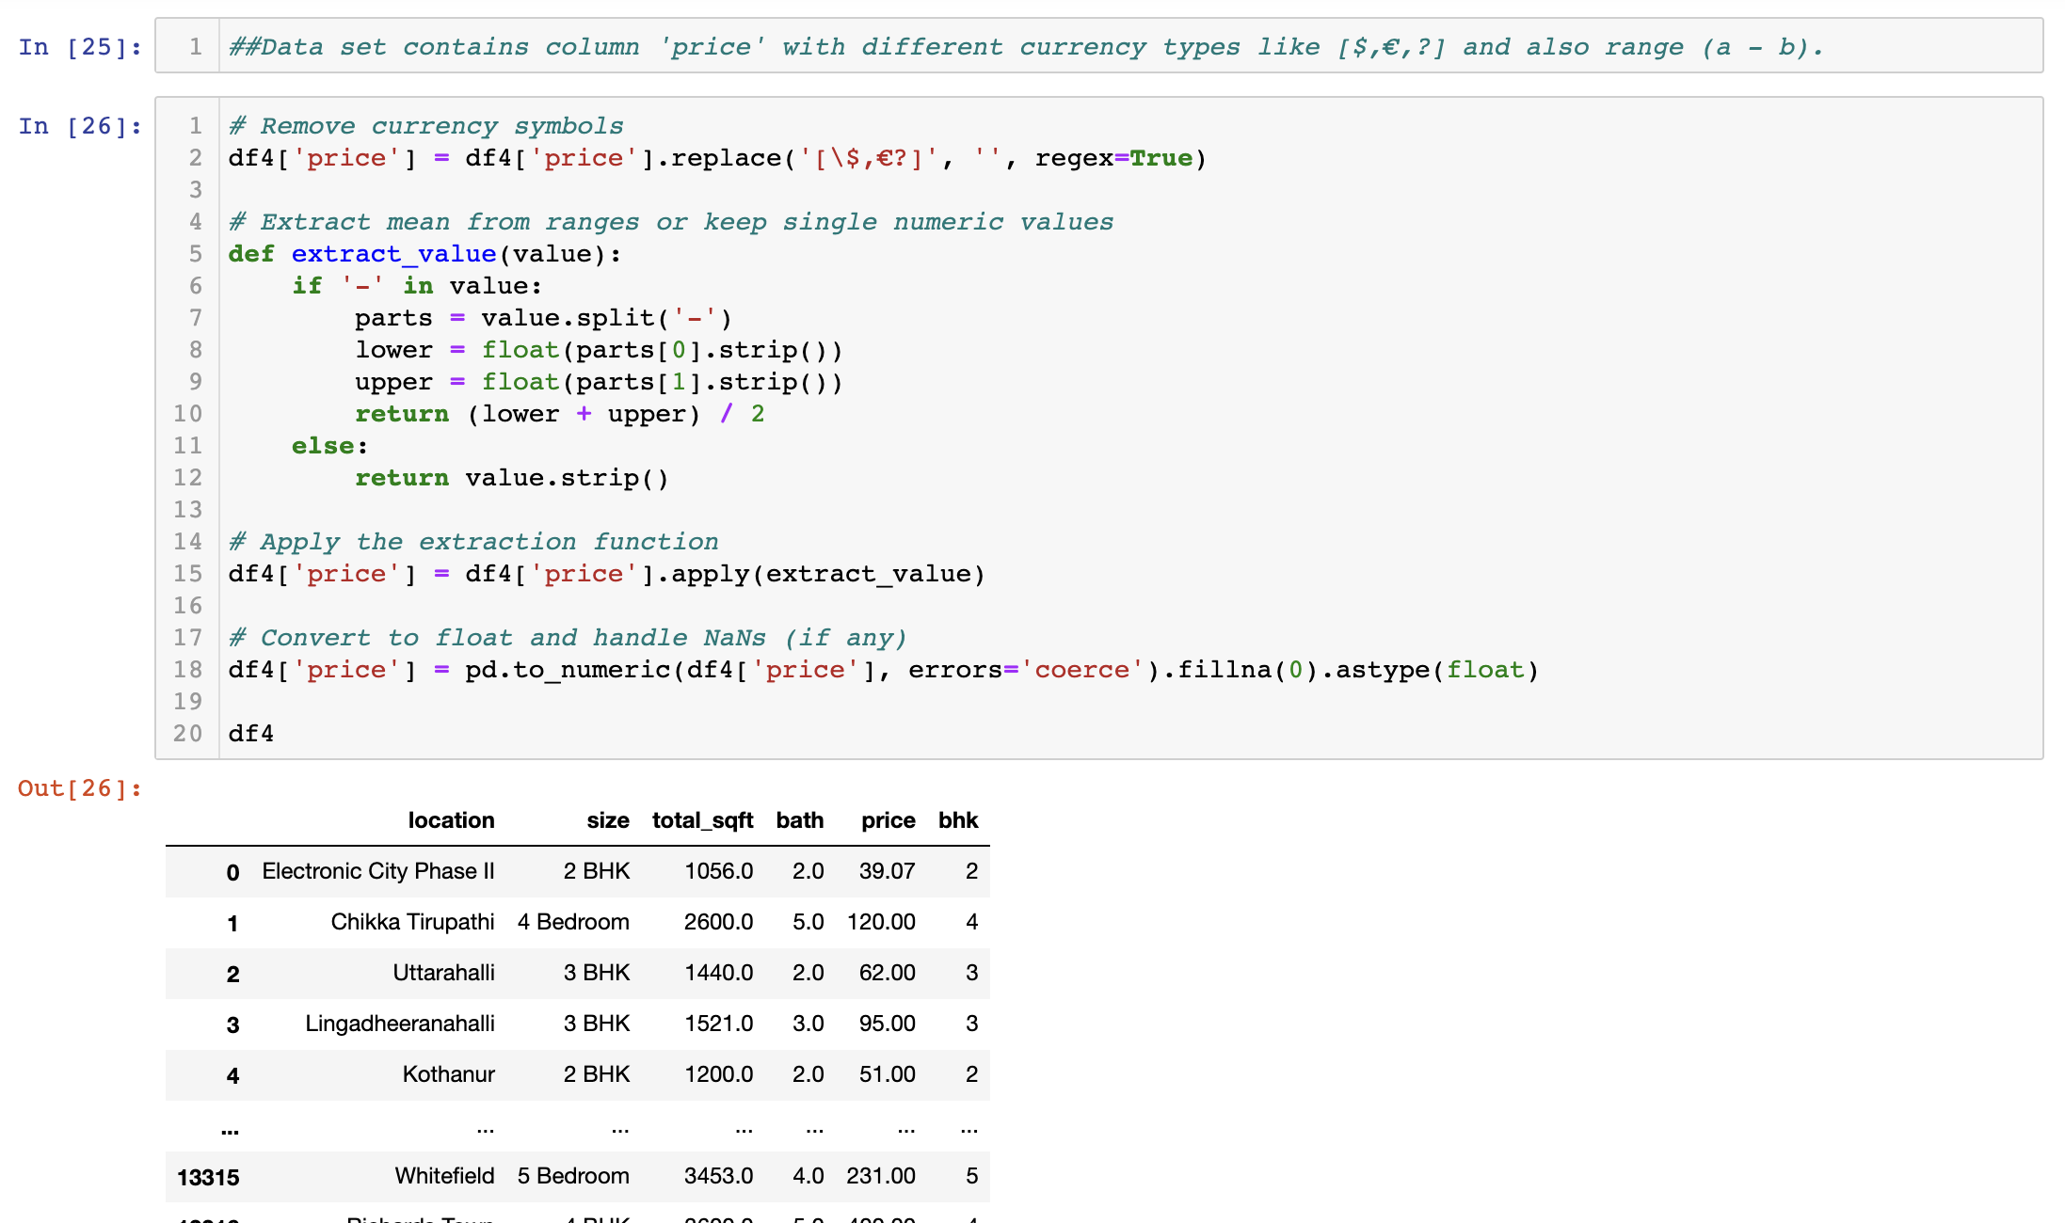
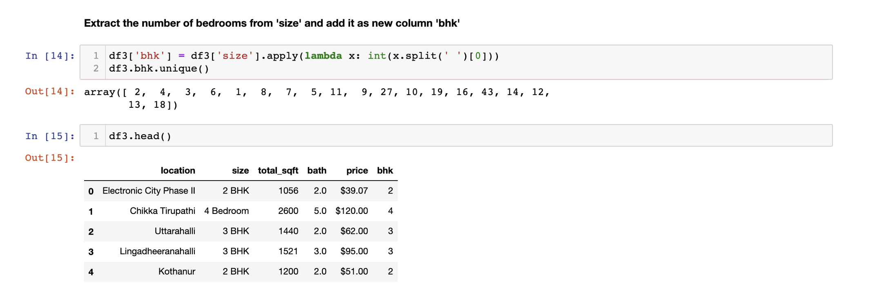
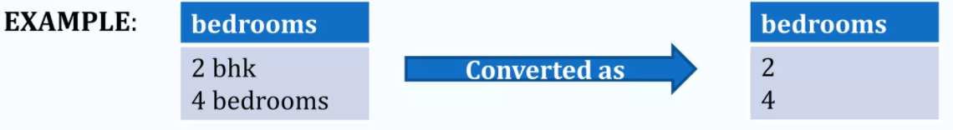
DATA CLEANING
Dirty data can lead to erroneous conclusions and flawed analyses, which can have significant consequences.
Data Cleaning involves understanding and removing Dirty Data:
* Missing values. * Outliers (Z score Method / IQR Method)
* Duplicates. * Erroneous Data * Inconsistencies
Columns that are not relevant are dropped from our dataset.
Rows having null values are identified and replaced / dropped.
Columns having characters as well as integer values are converted into integer values only.

Slide 7
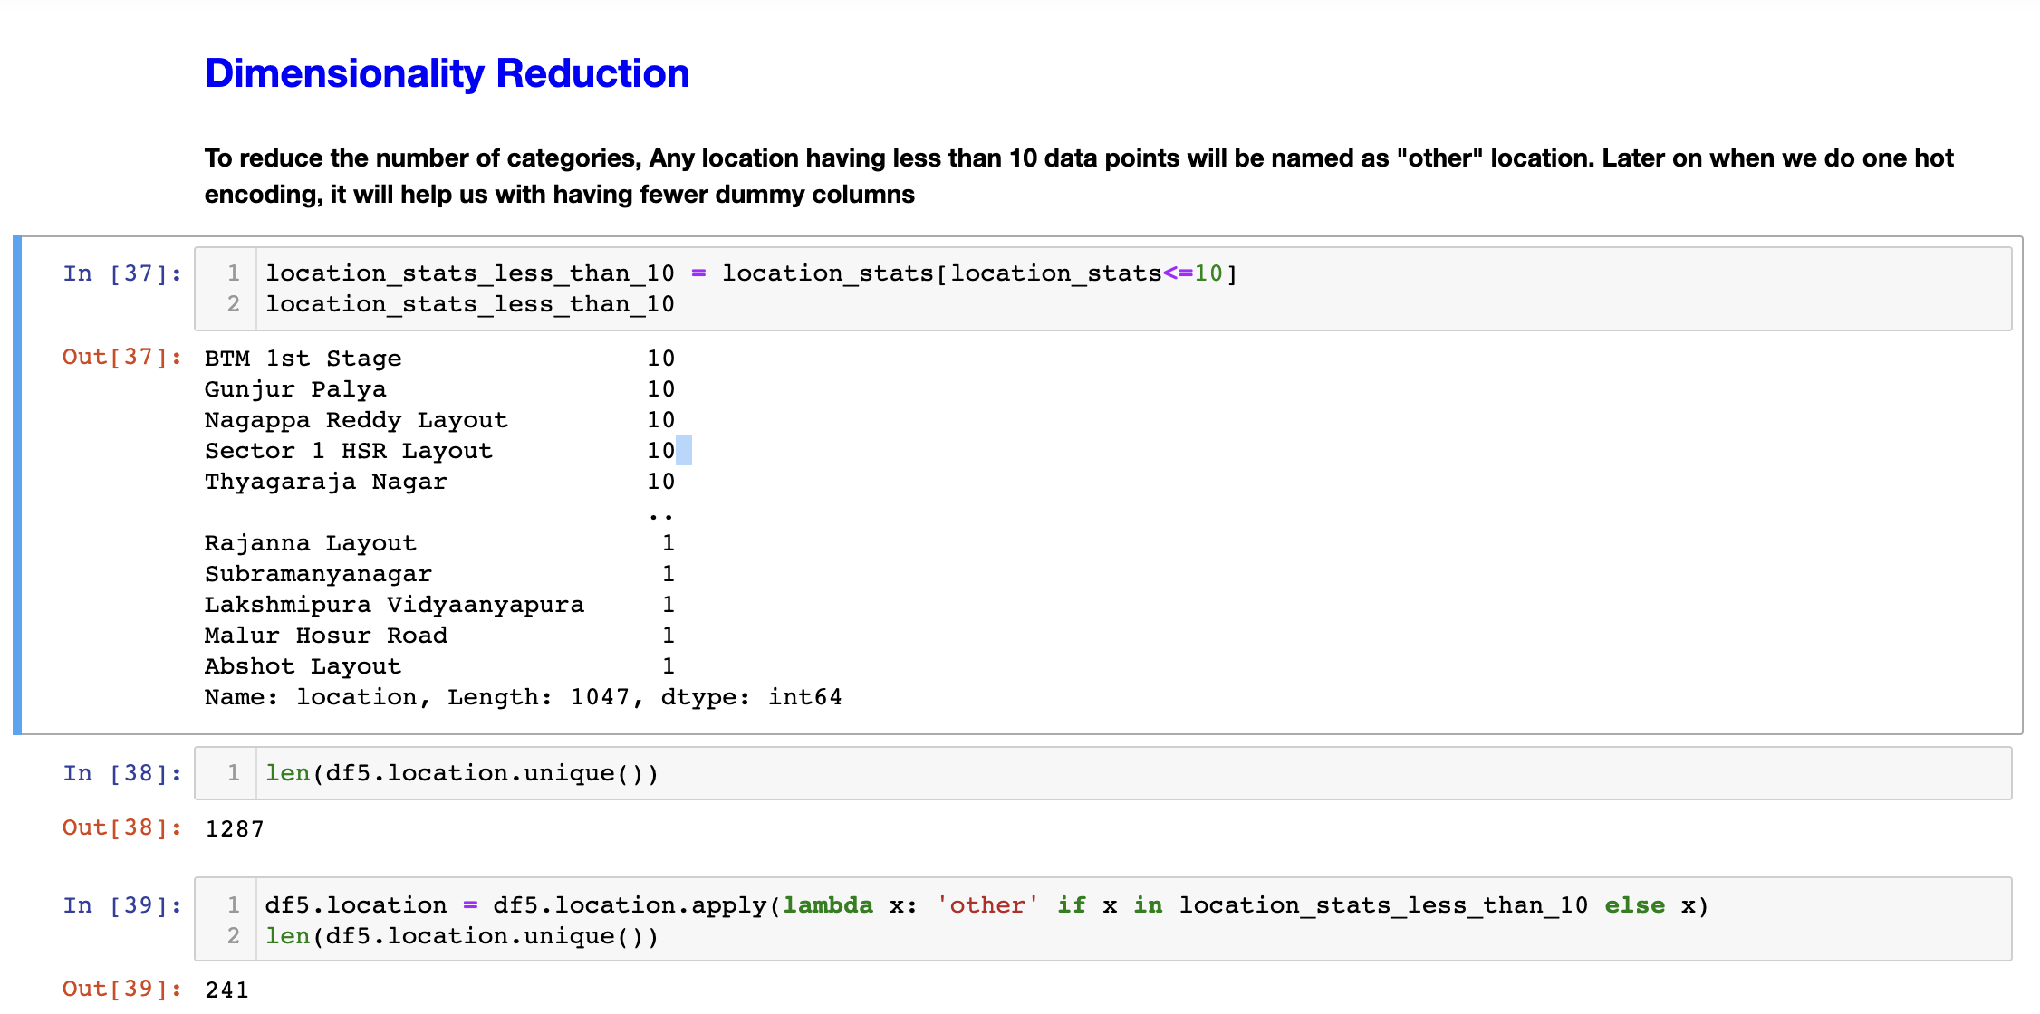
FEATURE ENGINEERING TECHNIQUES
Feature engineering involves leveraging domain expertise to transform raw data into meaningful features through data mining techniques, which are used to enhance the performance of machine learning algorithms.
Feature engineering is a crucial step in machine learning model development involving the creation of new features or the modification of existing ones.
Dimensionality reduction techniques are used in our dataset to reduce those rows who are not very much important to decide the house price.

Slide 8
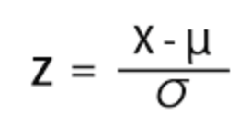
OUTLIER DETECTION
Many outliers are visible when the data is plotted, but you can also use statistical methods to identify outliers.
A common method is to calculate a Z-score for each data point and eliminate the values with an extreme Z-score.
Another method is to calculate the interquartile range (IQR) of the distribution and classify any values that are Q1-(1.5 x IQR) or Q3 + (1.5 x IQR) as potential outliers.
We have also used simple domain knowledge of real estate market to detect the outliers in our dataset.

Slide 9
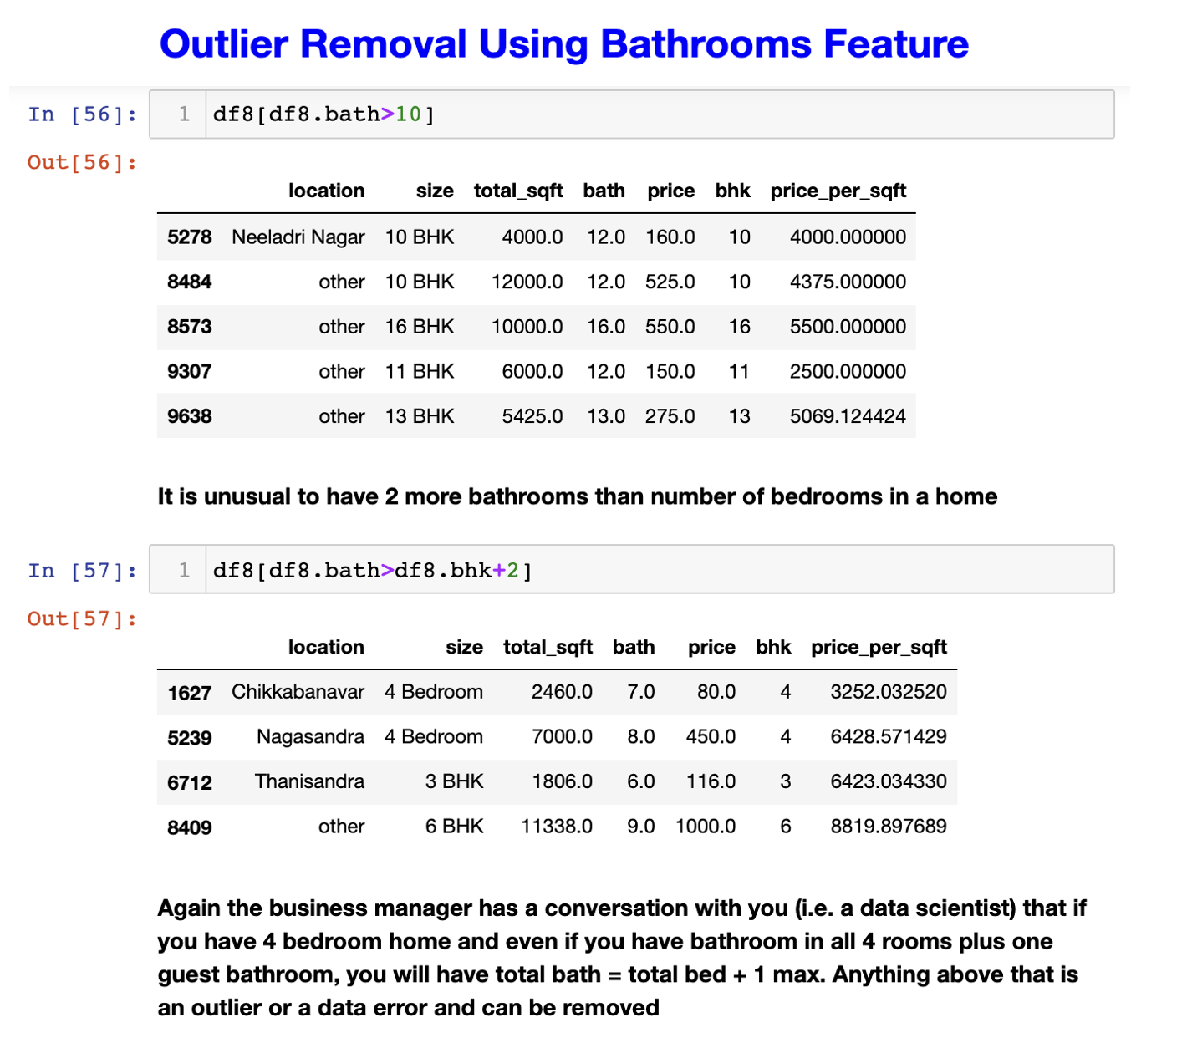
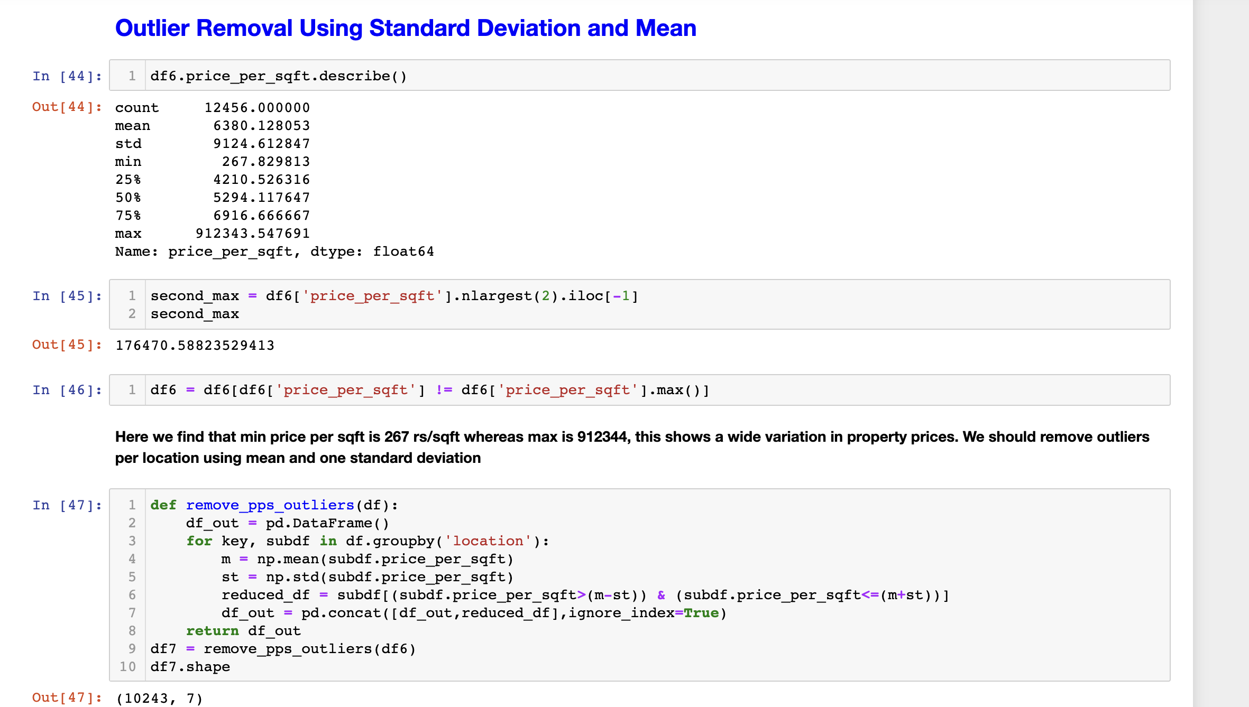
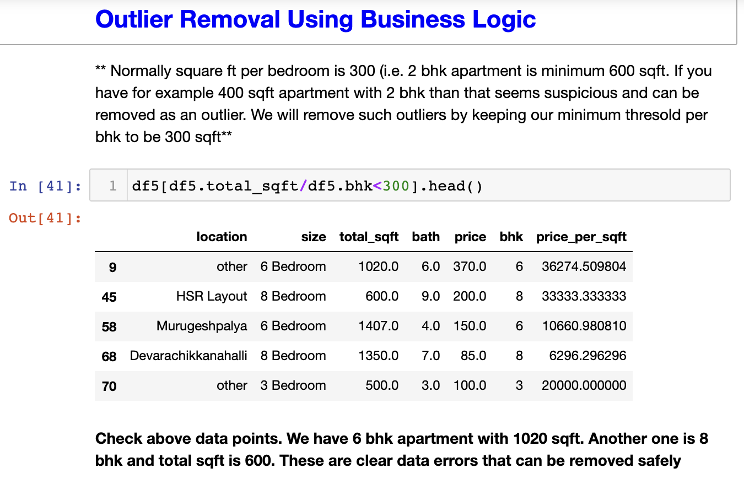
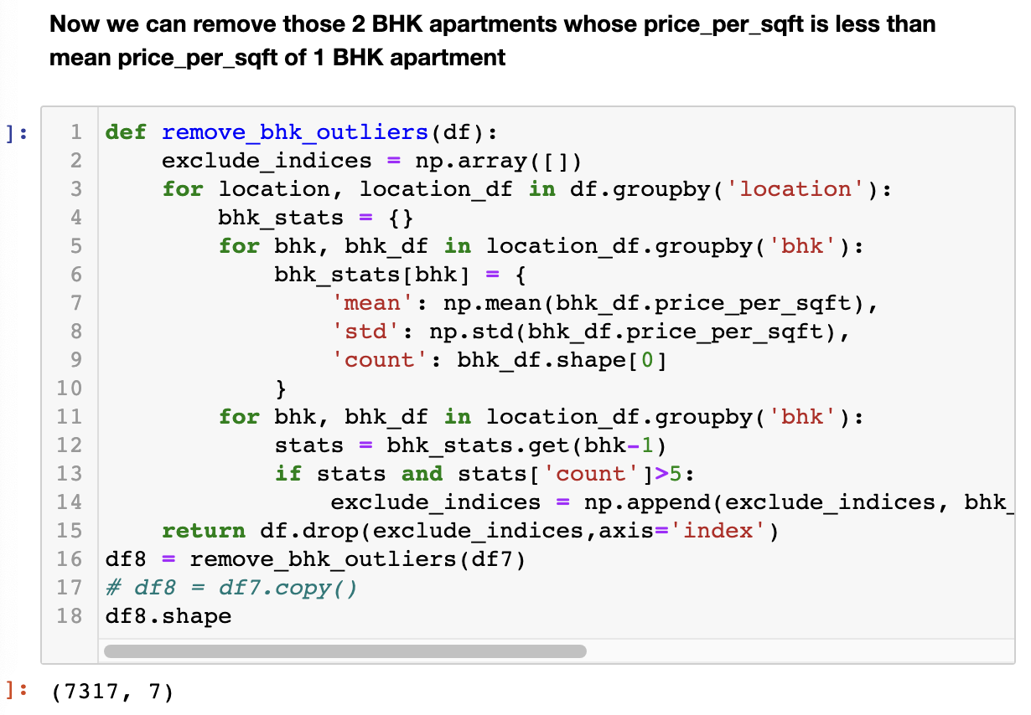
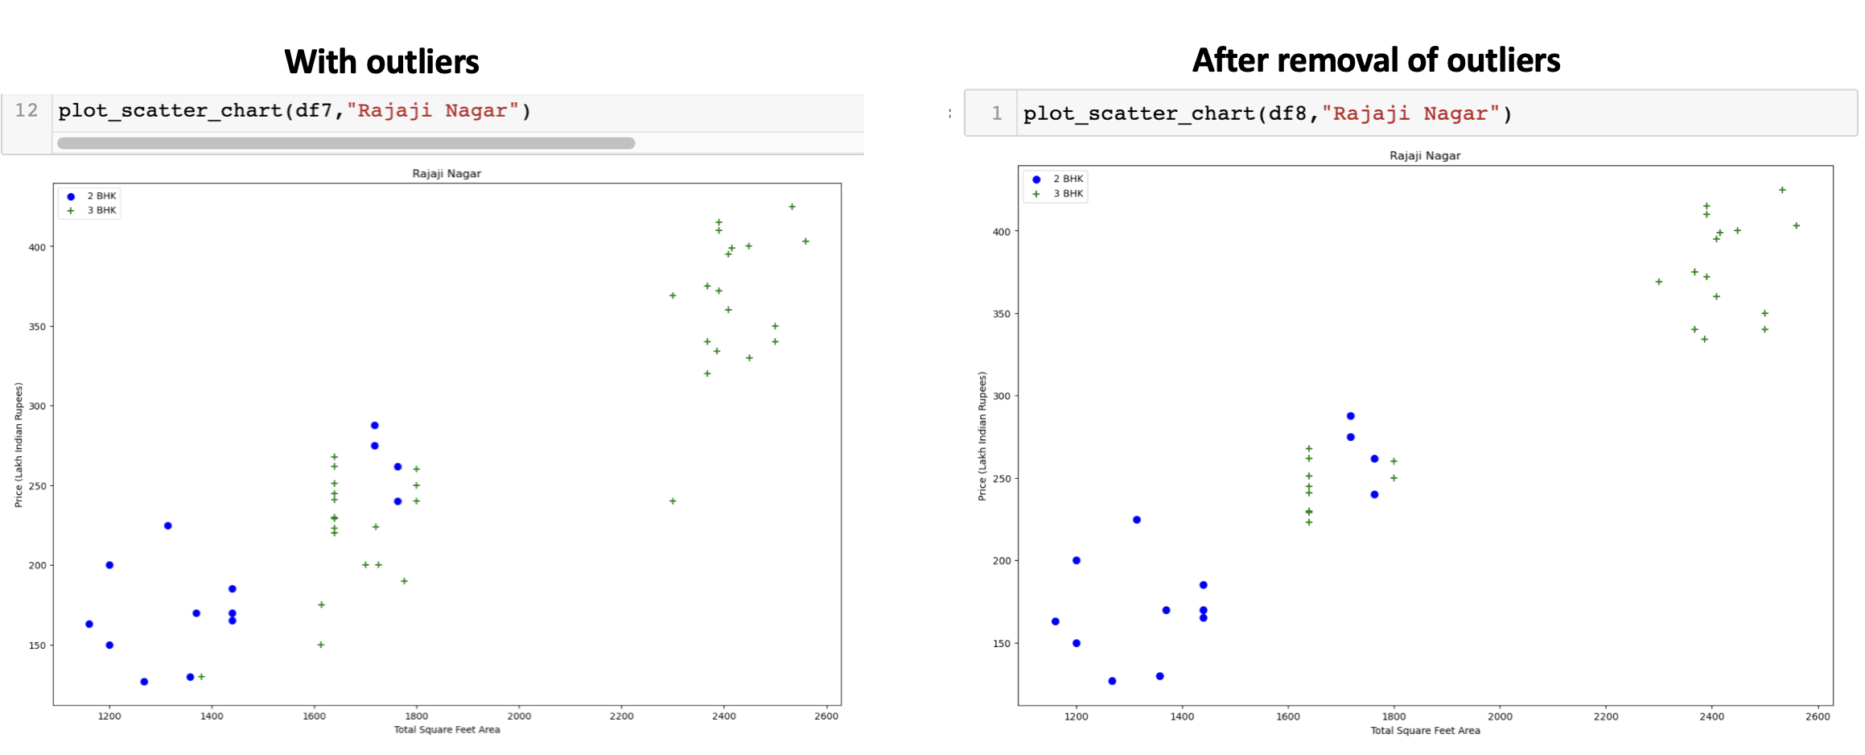
OUTLIER REMOVAL
It may be possible to remove the outlier from the dataset or replace it with a less extreme value that retains the overall shape of the distribution.
Capping is a method where you set a cap, or threshold, on your data’s distribution and replace any values outside those bounds with a specified value.
In our dataset, we could figure out variations In the relation between values of some attributes. We have removed those readings.
E.g. Price get reduced for higher values of bathroom, bedroom for a location.
Scatter plots gives us visualization of outliers and have accordingly checked if removal was successful or not.

Slide 10
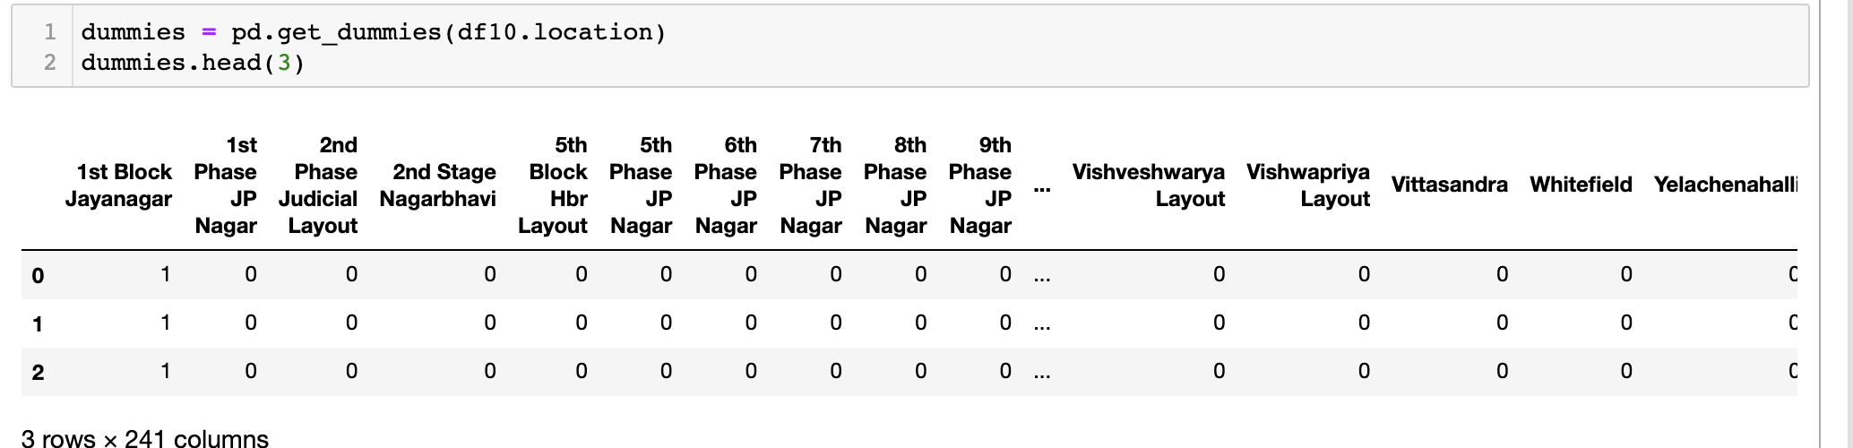
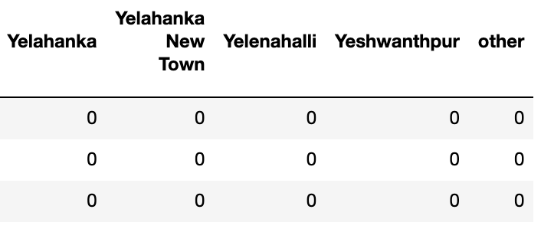
ONE HOT ENCODING
Encoding categorical variables is an essential preprocessing step in machine learning when dealing with features that are not numerical.
One common technique for encoding categorical variables where there is no inherent order or hierarchy is one-hot encoding, which transforms each category into a binary vector.
Our dataset contains a categorical variable which is “location”.

Slide 11
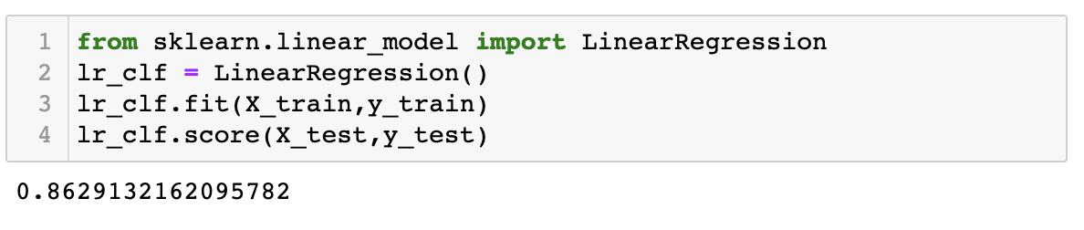

MODEL CREATION
We have used Linear Regression algorithm for train/test of the model. The interpretability of linear regression is a notable strength.
Its simplicity is a virtue, as linear regression is transparent, easy to implement, and serves as a foundational concept for more complex algorithms.
Our primary objective while using linear regression is to locate the best-fit line. There will be the least error in the best-fit line.
Cost function for Linear Regression: The cost function or the loss function is nothing but the error or difference between the predicted value Y^ and the true value Y.

Slide 12
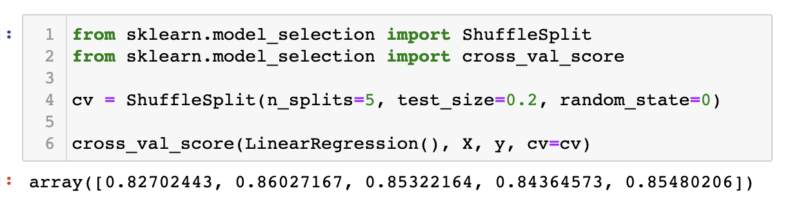
K-FOLD CROSS VALIDATION
Cross-validation is a technique used to assess the performance of machine learning models.
The procedure has a single parameter called k that refers to the number of groups that a given data sample is to be split into and the procedure is often called k-fold cross-validation.
Upon application of K-fold cross validation method to our dataset, accuracy rate is found at more than 80% in all cases with K=5.

Slide 13
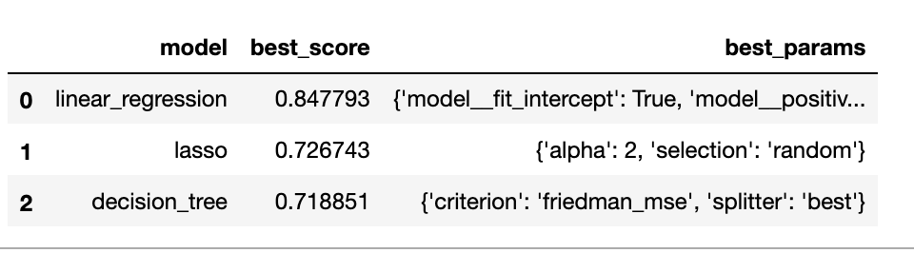
GRID SEARCH CROSS VALIDATION
GridSearchCV is a technique for finding the optimal modeling algorithm and parameter values from a given set of parameters in a grid.
GridSearchCV is the process of performing hyperparameter tuning in order to determine the optimal values for a given model.
On our dataset, GridSearchCV method is used to find the best model among linear regression, lasso and decision tree.

Slide 14



RESULTS
We then created a function so that the model will predict the house price for random input given for location, sqft area, bathrooms and bedrooms.
Output received as follows:
INSIGHTS
• Refine Pricing Strategies: Develop more effective pricing models to maximize revenue and market competitiveness.
• Deliver Critical Insights: Empower buyers and sellers with actionable information to make informed decisions.
• Enhance Market Decision-Making: Support smarter choices in the real estate market through data-driven insights.

Slide 15


